Slide 1
Amazon Sales Data Analysis
Presented by Patnala Gowtham Satya Sai Achari

Slide 2
Overview
Problem Statement
Data Used
Item Type v/s Total Revenue
Order Priority
Key Metrics
Correlation of Attributes
Month, Year, Year-Month wise Sales
Conclusion

Slide 3
Problem Statement
Sales management has gained importance to meet increasing competition and the need for improved methods of distribution to reduce cost and to increase profits. Sales management today is the most important function in a commercial and business enterprise.
To find the Sales-trend: month-wise, year-wise, yearly month-wise.

Slide 4
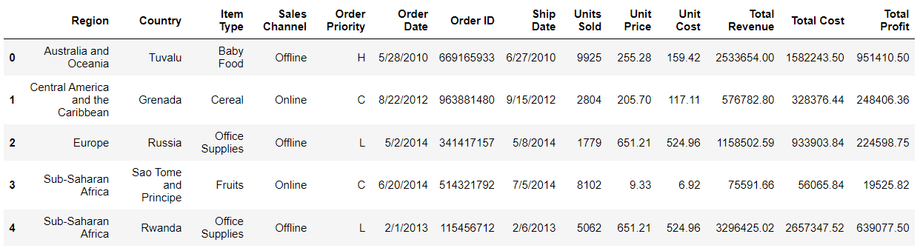
Data Used
The Data Contains 100 rows of data and 14 columns of attributes.
data.head()

Slide 5
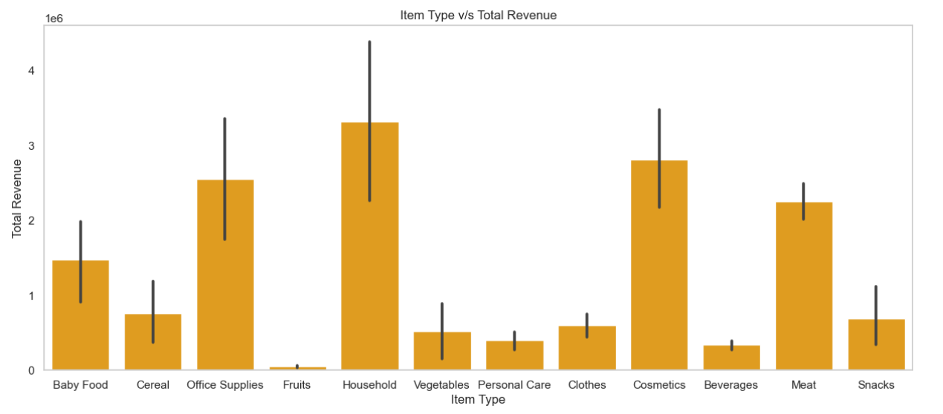
Item Type v/s Total Revenue
There are 13 types of Item. Highest revenue from Household

Slide 6
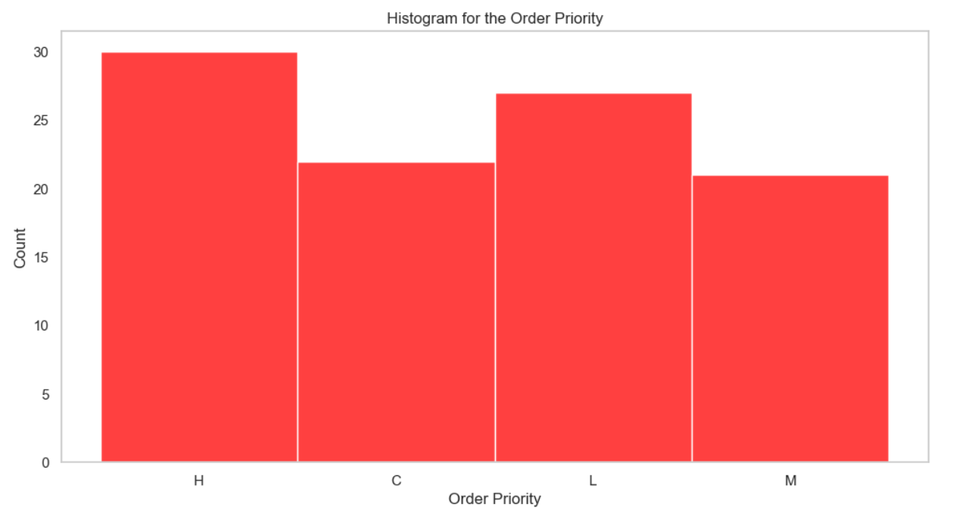
Order Priority
They are divided into 4 categories : H, C, M and L. “H” being the max priority.

Slide 7
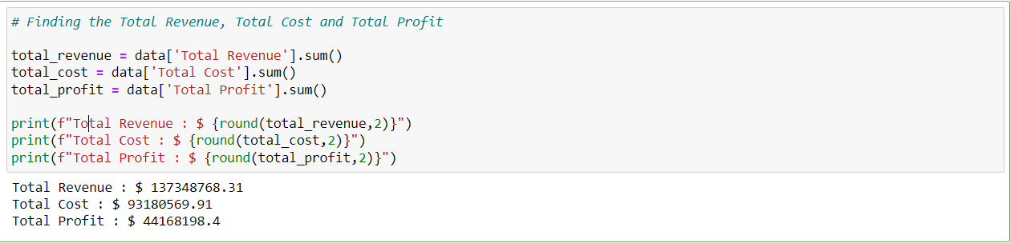
Key Metrics:
Total Revenue generated : $ 137348768.31
Total Cost : $ 93180569.91
Total Profit earned : $ 44168198.4

Slide 8
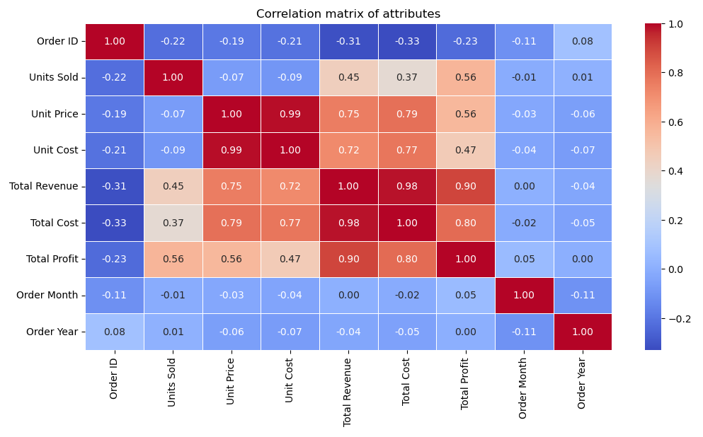
Correlation of Attributes
It defines how the attributes are co related.

Slide 9
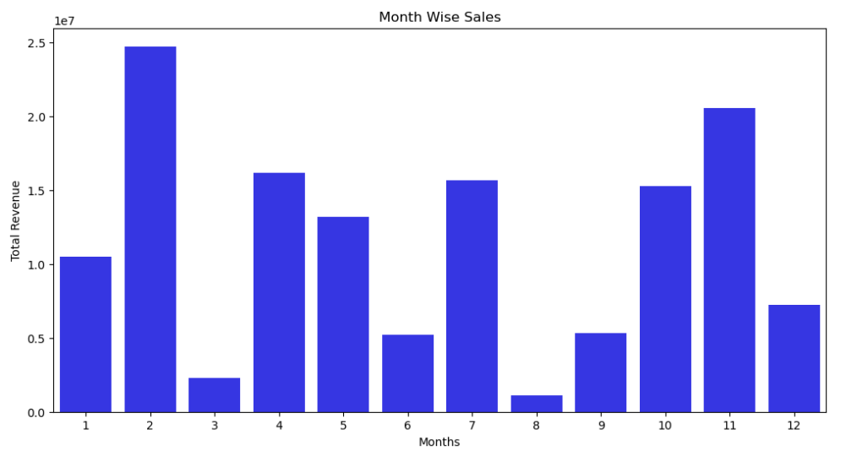
Month Wise Sales
February has the Sales and August has the lowest sales.

Slide 10
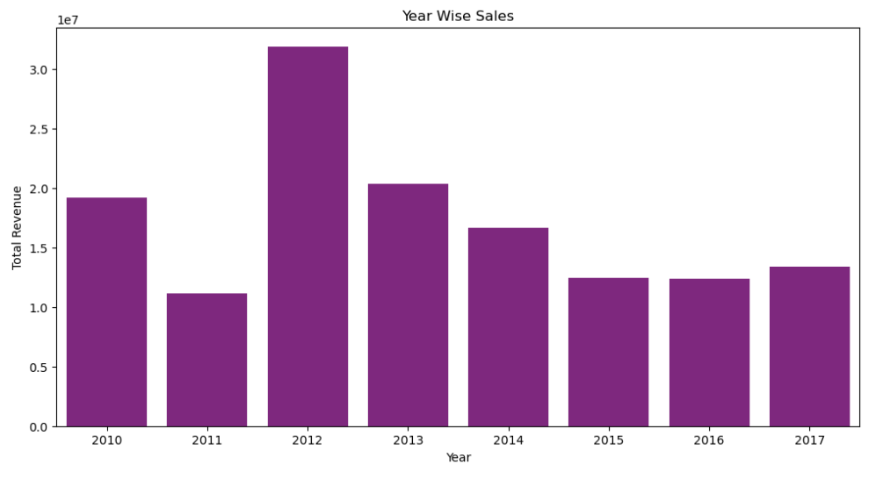
Year Wise Sales
2011 has the lowest sales but sales growing exponentially in 2012.

Slide 11
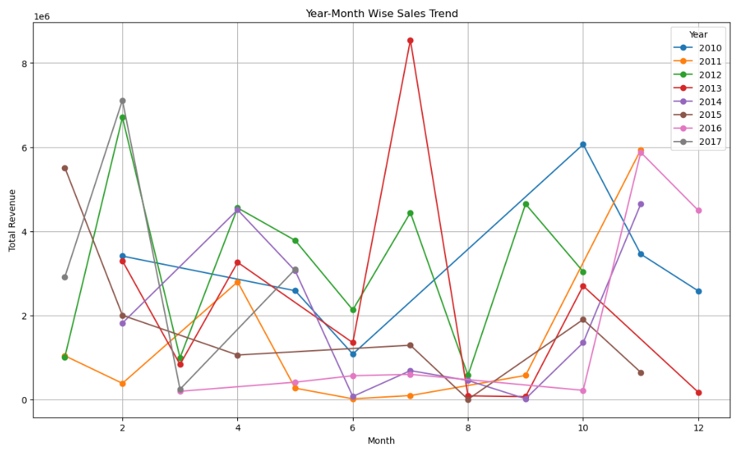
Year-Month Wise Sales
Highest Sales was recorded in July of 2013

Slide 12
Conclusion
The data given has 100 unique rows of data with 14 attributes.
Most Number of Item Types sold included Clothes and Cosmetics followed by office Supplies.
Highest Number of Revenue Generated from Item Type was from 'Household' and the lowest was from the 'Fruits'.
There are Equal Number of sales came from the online and the offline mode (i.e. 50 from online and 50 from the offline).
Given data has the most number of 'High' Order Priority, which means customers are likely to order for urgent deliveries.
Most Sales came from the month of ‘February' and least came from the month of 'August'.
Most Sales came in the year of '2012'.
While looking at the Year-Month Wise Sales Trend, the highest revenue generated was from the month of 'JULY' in the year '2013', whereas the least revenue generated was from the month of 'AUGUST' and 'SEPTEMBER' in the year '2015' and '2014' respectively.
Total Revenue : $ 137,348,768.31
Total Cost : $ 93,180,569.91.
Total Profit : $ 44,168,198.40

Slide 13
Thank You
_____________

